Slide 1
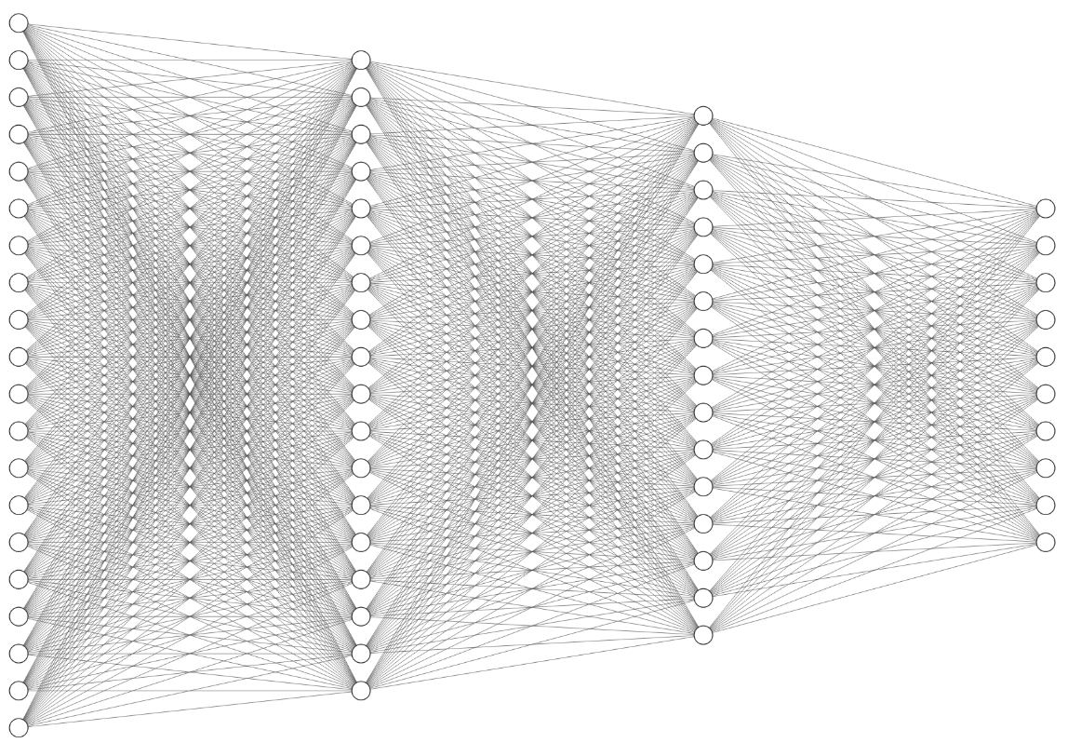
Input Nodes: 784
1st Hidden layer: 128
2nd Hidden layer: 64
Output layer: 10

